Slide 1
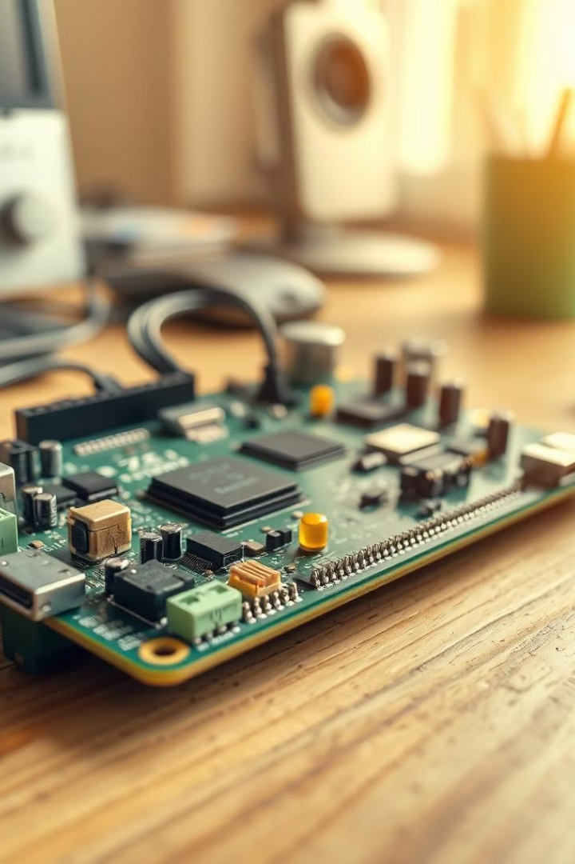
ELDER FALLING DETECTION USING SPI PROTOCOL WITH ADXL345 IMPLEMENTING ON FPGA BOARD
CH.RAMGOPAL
B.C.GOVARDHAN
G.STALIN

Slide 2
Importance of Fall Detection in Elderly Care
Falls are a leading cause of injury and death among the elderly.
Elderly individuals often live alone or remain unsupervised.
Manual alert systems (like panic buttons) may fail if the person is unconscious.
Delayed assistance can lead to severe complications, disabilities, or fatality.
An automatic fall detection system ensures quick response and enhances safety.

Slide 3
Brief Overview of the Proposed Solution
A real-time fall detection system using:
ADXL345 accelerometer to detect motion and falls.
SPI protocol for high-speed communication with FPGA.
FPGA board to process sensor data and detect falls.
When a fall is detected:
The system triggers an alert (LED, buzzer, or signal output).
Designed to be fast, reliable, and suitable for elderly care environments.

Slide 4
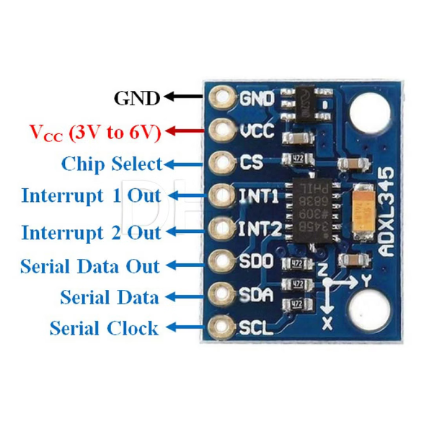
ADXL345 SENSOR
The ADXL345 is a small, thin, ultra-low power 3-axis digital accelerometer.
Capable of measuring acceleration in X, Y, and Z directions.
Widely used for motion sensing, orientation detection, and fall detection.

Slide 5
Key Features
Measurement Range: ±2g, ±4g, ±8g, ±16g (configurable)
Output Resolution: 10 to 13-bit
Interface:
SPI (4-wire) or I2C digital communication
Power Supply: 2.0V to 3.6V
Low Power Consumption: Ideal for wearable or portable devices
Data Rate: Up to 3200 Hz

Slide 6
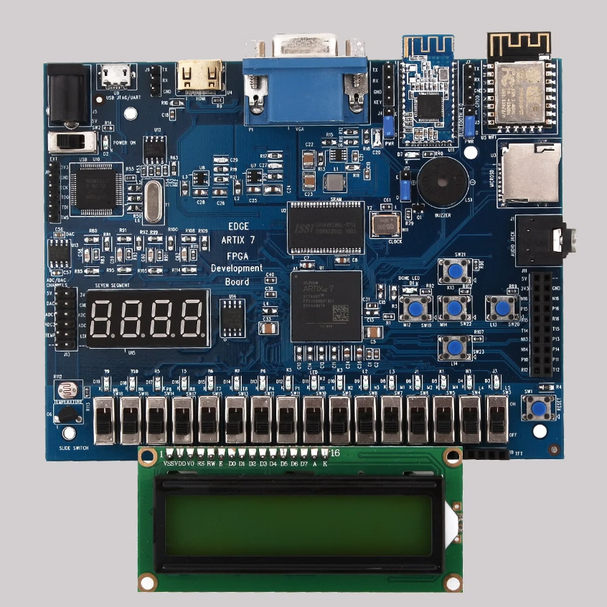
FPGA
Field Programmable Gate Array.
It's a reconfigurable digital logic device used to implement custom hardware functions using HDL (like Verilog or VHDL).
Unlike microcontrollers, FPGAs perform parallel processing and are ideal for real-time applications like fall detection.

Slide 7
Pin Type
Function
I/O Pins
General-purpose input/output for sensors, buttons, etc.
VCC / GND
Power supply and ground pins
Clock (CLK)
Provides timing signal to internal logic
Programming Pins
Used for flashing/configuring the FPGA
Dedicated SPI Pins (optional)
For high-speed SPI communication (MISO, MOSI, SCLK, CS)

Slide 8
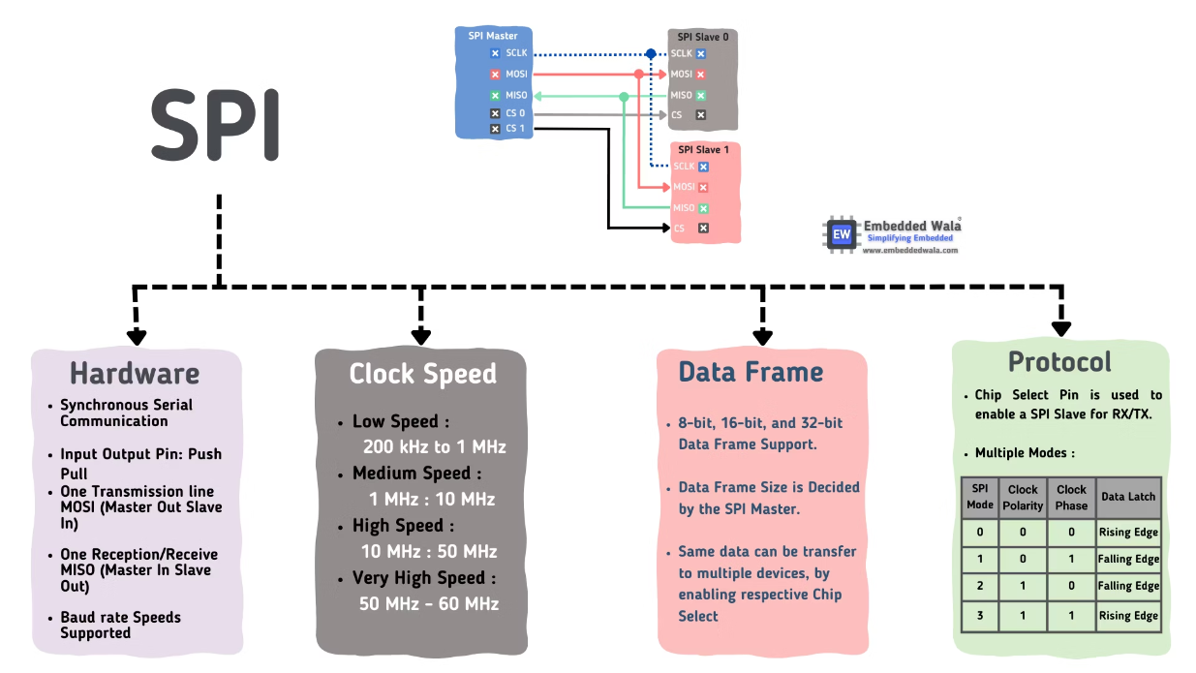
SPI -SERIAL PERIPHERAL INTERFACE

Slide 9
SPI Bus Lines
Line
Direction
Description
MOSI
Master → Slave
Master Out, Slave In – Data from FPGA to ADXL345
MISO
Slave → Master
Master In, Slave Out – Data from ADXL345 to FPGA
SCLK
Master → Slave
Serial Clock – Generated by FPGA
CS
Master → Slave
Chip Select – Active LOW to enable sensor
Master vs Slave
FPGA acts as the SPI Master: It initiates communication, generates the clock (SCLK), and controls CS.
ADXL345 acts as the SPI Slave: It responds to commands sent by the master.

Slide 10
Communication Workflow
CS (Chip Select) goes LOW to start communication.
FPGA sends command over MOSI to request data (e.g., read X, Y, Z registers).
FPGA generates clock pulses on SCLK for each bit transfer.
ADXL345 sends response data back over MISO.
CS goes HIGH to end the communication session.

Slide 11
Advantages
Real-Time Processing (FPGA)
High-Speed Communication (SPI)
Accurate Motion Detection (ADXL345)
Hardware Flexibility
Low Power Sensor
Modular Design

Slide 12
Disadvantages
Complex Design & Development
Limited Onboard Resources
No Standard Fall Pattern
Need for Extensive Testing.
Power-Hungry (FPGA)
Cost

Slide 13
Applications of the Fall Detection System
Elderly Care Homes
Home-Based Monitoring
Medical Emergency Systems
Wearable Health Devices
Rehabilitation Centers
Smart Homes & IoT Integration
Mobility & Gait Analysis

Slide 14
CONCLUSION
Through the integration of ADXL345 sensors, SPI communication, and FPGA logic, we have developed a real-time, reliable, and efficient fall detection system tailored for the elderly — where every second can save a life.
Hardware precision meets healthcare necessity.
FPGA ensures instant processing — no delay, no dependency.
The system is non-intrusive, wearable, and adaptable to everyday life.
We envision a future where:
AI enhances detection
Wireless alerts save more lives
And every home becomes a smart guardian for our elders.

Slide 15
THANK YOU

